Slide 1
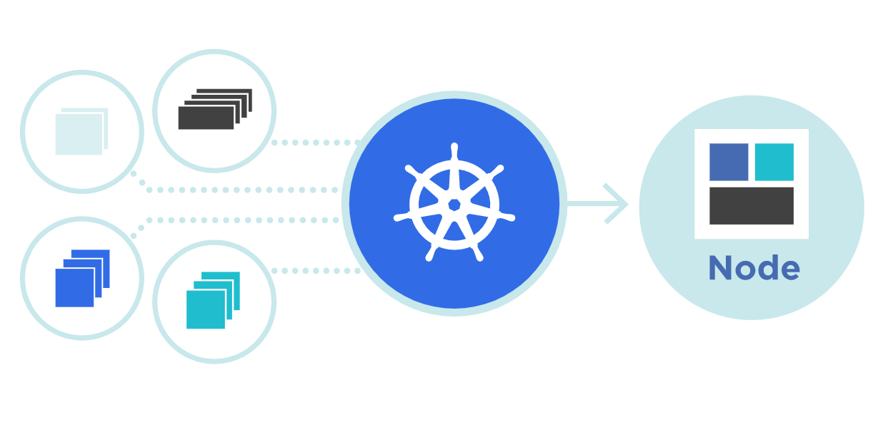




DaemonSet
Theory + LAB + Documents ➔ All free
WATCH NOW
Notes:
Hello everyone. My name is Anish Rana and you are watching Kubernetes web series.
Today, we're going to cover one interesting topic, i.e. “What is DaemonSet?"

Slide 2
Agenda of this video.
What is DaemonSet?
Use cases of DaemonSet.
Understand the fields in yaml file.
How to create Yaml file for Daemonset?
How to create DaemonSet?
How to check the DaemonSet?
Update Strategy for DaemonSet
How to delete the DaemonSet?
LAB

Slide 3
01 NOW WE WILL TALK ABOUT
What is DaemonSet?
Use cases of DaemonSet.
Understand the fields in yaml file.
How to create Yaml file for Daemonset?
How to create DaemonSet?
How to check the DaemonSet?
Update Strategy for DaemonSet
How to delete the DaemonSet?
LAB

Slide 4


apiVersion: apps/v1
kind: Deployment
metadata:
name: nginx-Deployment
labels:
app: nginx
spec:
replicas: 2
selector:
matchLabels:
app: nginx
template:
metadata:
labels:
app: nginx
spec:
containers:
- name: nginx
image: nginx:1.14.2
ports:
- containerPort: 80
WorkerNode 1
WorkerNode 2
Master Node 1
WorkerNode 3

Slide 5
WorkerNode 1
apiVersion: apps/v1
kind: DaemonSet
metadata:
name: nginx- DaemonSet
labels:
app: nginx
spec:
selector:
matchLabels:
app: nginx
template:
metadata:
labels:
app: nginx
spec:
containers:
- name: nginx
image: nginx:1.14.2
ports:
- containerPort: 80
Master Node 1
WorkerNode 2
WorkerNode 3
WorkerNode 4

Slide 6
Daemonset is a resource object in Kubernetes that provides declarative updates to applications.
We instruct Kubernetes system through objects that how we want our cluster’s workload to look.
Daemonset is the part of Controller like Deployment.

Slide 7

Worker node 1 / VM
Master node 1 / VM
Schedular
POD 1
C: webapp1
Kubelet
API Server
Etcd Database
Kube-Proxy
POD 2
C: database1
Controller
Kubernetes
Kubernetes
Docker Engine
Docker Engine
CentOS 9
CentOS 9

Slide 8
Daemonset is a resource object in Kubernetes that provides declarative updates to applications.
We instruct Kubernetes system through objects that how we want our cluster’s workload to look.
Daemonset is the part of Controller like Deployment.
Once the object created, our controller checks the desired & current state.

Slide 9
A DaemonSet ensures that all (or some) Nodes run a copy of a Pod.
If nodes are added to the cluster, Pods are added to them.
As nodes are removed from the cluster, those Pods are also deleted.
Deleting a DaemonSet will clean up the Pods it created.

Slide 10
02 NOW WE WILL TALK ABOUT
01 What is DaemonSet?
02 Use cases of DaemonSet.
03 Understand the fields in yaml file.
04 How to create Yaml file for Daemonset?
05 How to create DaemonSet?
06 How to check the DaemonSet?
07 Update Strategy for DaemonSet
08 How to delete the DaemonSet?
08 LAB

Slide 11
Running a cluster storage daemon on every node
Running a logs collection daemon on every node
Running a node monitoring daemon on every node

Slide 12
03 NOW WE WILL TALK ABOUT
1. What is DaemonSet?
2. Use cases of DaemonSet.
3. Understand the fields in yaml file.
4. How to create Yaml file for Daemonset?
5. How to create DaemonSet?
6. How to check the DaemonSet?
7. Update Strategy for DaemonSet
8. How to delete the DaemonSet?
9. LAB

Slide 13
apiVersion: apps/v1
kind: DaemonSet
metadata:
name: nginx- DaemonSet
labels:
app: nginx
spec:
selector:
matchLabels:
app: nginx
template:
metadata:
labels:
app: nginx
spec:
containers:
- name: nginx
image: nginx:1.14.2
ports:
- containerPort: 80

Slide 14
04 NOW WE WILL TALK ABOUT
1. What is DaemonSet?
2. Use cases of DaemonSet.
3. Understand the fields in yaml file.
4. How to create Yaml file for Daemonset?
5. How to create DaemonSet?
6. How to check the DaemonSet?
7. Update Strategy for DaemonSet
8. How to delete the DaemonSet?
9. LAB

Slide 15
From the command line (kubectl create)
Through yaml file

Slide 16
kubectl create deployment test1-daemonset --image=nginx:1.14.2 --dry-run=client -oyaml
apiVersion: apps/v1
kind: Deployment
metadata:
creationTimestamp: null
labels:
app: test1-daemonset
name: test1-daemonset
spec:
replicas: 1
selector:
matchLabels:
app: test1-daemonset
strategy: {}
template:
metadata:
creationTimestamp: null
labels:
app: test1-daemonset
spec:
containers:
- image: nginx:1.14.2
name: nginx

Slide 17
apiVersion: apps/v1
kind: Deployment
metadata:
creationTimestamp: null
labels:
app: test1-daemonset
name: test1-daemonset
spec:
replicas: 1
selector:
matchLabels:
app: test1-daemonset
strategy: {}
template:
metadata:
creationTimestamp: null
labels:
app: test1-daemonset
spec:
containers:
- image: nginx:1.14.2
name: nginx
apiVersion: apps/v1
kind: DaemonSet
metadata:
creationTimestamp: null
labels:
app: test1-daemonset
name: test1-daemonset
spec:
selector:
matchLabels:
app: test1-daemonset
template:
metadata:
creationTimestamp: null
labels:
app: test1-daemonset
spec:
containers:
- image: nginx:1.14.2
name: nginx

Slide 18

From the command line (kubectl create)
Through yaml file

Slide 19
05 NOW WE WILL TALK ABOUT
1. What is DaemonSet?
2. Use cases of DaemonSet.
3. Understand the fields in yaml file.
4. How to create Yaml file for Daemonset?
5. How to create DaemonSet?
6. How to check the DaemonSet?
7. Update Strategy for DaemonSet
8. How to delete the DaemonSet?
9. LAB

Slide 20
apiVersion: apps/v1
kind: DaemonSet
metadata:
creationTimestamp: null
labels:
app: test1-daemonset
name: test1-daemonset
spec:
selector:
matchLabels:
app: test1-daemonset
template:
metadata:
creationTimestamp: null
labels:
app: test1-daemonset
spec:
containers:
- image: nginx:1.14.2
name: nginx
[root@master1 ~]#
daemonset.apps/test1-daemonset created
kubectl create -f test-daemonset.yaml

Slide 21
06 NOW WE WILL TALK ABOUT
1. What is DaemonSet?
2. Use cases of DaemonSet.
3. Understand the fields in yaml file.
4. How to create Yaml file for Daemonset?
5. How to create DaemonSet?
6. How to check the DaemonSet?
7. Update Strategy for DaemonSet
8. How to delete the DaemonSet?
9. LAB

Slide 22
[root@master1 ~]# kubectl describe daemonsets test1-daemonset
Name: test1-daemonset
Selector: app=test1-daemonset
Node-Selector: <none>
Labels: app=test1-daemonset
Annotations: deprecated.daemonset.template.generation: 1
Desired Number of Nodes Scheduled: 2
Current Number of Nodes Scheduled: 2
Number of Nodes Scheduled with Up-to-date Pods: 2
Number of Nodes Scheduled with Available Pods: 2
Number of Nodes Misscheduled: 0
Pods Status: 2 Running / 0 Waiting / 0 Succeeded / 0 Failed
Pod Template:
Labels: app=test1-daemonset
Containers:
nginx:
Image: nginx:1.14.2
Port: <none>
Host Port: <none>
Environment: <none>
Mounts: <none>
Volumes: <none>
Events:
Type Reason Age From Message
---- ------ ---- ---- -------
Normal SuccessfulCreate 28m daemonset-controller Created pod: test1-daemonset-vt4rm
Normal SuccessfulCreate 28m daemonset-controller Created pod: test1-daemonset-vtrb2

Slide 23
[root@master1 ~]# kubectl get nodes
NAME STATUS ROLES AGE VERSION
master1.example.com Ready control-plane 77d v1.25.4
workernode1.example.com Ready <none> 77d v1.25.4
workernode2.example.com Ready <none> 77d v1.25.4
[root@master1 ~]# kubectl get pods -o wide | egrep -i "test|Name"
NAME READY STATUS RESTARTS AGE IP NODE NOMINATED NODE READINESS GATES
test1-daemonset-vt4rm 1/1 Running 0 42m 172.16.133.138 workernode1.example.com <none> <none>
test1-daemonset-vtrb2 1/1 Running 0 42m 172.16.14.85 workernode2.example.com <none> <none>

Slide 24
[root@master1 ~]# kubectl get daemonsets.apps
NAME DESIRED CURRENT READY UP-TO-DATE AVAILABLE NODE SELECTOR AGE
test1-daemonset 2 2 2 2 2 <none> 40h
[root@master1 ~]# kubectl get daemonsets/test1-daemonset
NAME DESIRED CURRENT READY UP-TO-DATE AVAILABLE NODE SELECTOR AGE
test1-daemonset 2 2 2 2 2 <none> 40h
kubectl get ds/test1-daemonset
[root@master1 ~]# kubectl get pods | egrep "test1-daemonset|NAME"
NAME READY STATUS RESTARTS AGE
test1-daemonset-vt4rm 1/1 Running 3 (10m ago) 40h
test1-daemonset-vtrb2 1/1 Running 3 (9m41s ago) 40h

Slide 25
07 NOW WE WILL TALK ABOUT
1. What is DaemonSet?
2. Use cases of DaemonSet.
3. Understand the fields in yaml file.
4. How to create Yaml file for Daemonset?
5. How to create DaemonSet?
6. How to check the DaemonSet?
7. Update Strategy for DaemonSet
8. How to delete the DaemonSet?
9. LAB

Slide 26
DaemonSet has two update strategy types:
OnDelete:
After update, the DaemonSet template, new DaemonSet pods will only be created when we delete the old pods.
RollingUpdate
After you update a DaemonSet template, old DaemonSet pods will be killed, and new DaemonSet pods will be created automatically, in a controlled fashion.

Slide 27
[root@master1 ~]# kubectl edit daemonsets.apps/test1-daemonset
[root@master1 ~]# vi test-daemonset.yaml
[root@master1 ~]# kubectl apply -f test-daemonset.yaml
[root@master1 ~]# kubectl rollout status ds/test1-daemonset
daemon set "test1-daemonset" successfully rolled out
[root@master1 ~]# kubectl set image ds/test1-daemonset nginx=nginx:1.16.1
daemonset.apps/test1-daemonset image updated

Slide 28
08 NOW WE WILL TALK ABOUT
1. What is DaemonSet?
2. Use cases of DaemonSet.
3. Understand the fields in yaml file.
4. How to create Yaml file for Daemonset?
5. How to create DaemonSet?
6. How to check the DaemonSet?
7. Update Strategy for DaemonSet.
8. How to delete the DaemonSet?
9. LAB

Slide 29
[root@master1 ~]# kubectl get ds/test1-daemonset
NAME DESIRED CURRENT READY UP-TO-DATE AVAILABLE NODE SELECTOR AGE
test1-daemonset 2 2 2 2 2 <none> 2d
[root@master1 ~]# kubectl get pods -o wide | grep test1
NAME READY STATUS RESTARTS AGE IP NODE NOMINATED NODE READINESS GATES
test1-daemonset-92pzr 1/1 Running 0 3h55m 172.16.133.162 workernode1.example.com <none> <none>
test1-daemonset-pnt68 1/1 Running 0 3h55m 172.16.14.88 workernode2.example.com <none> <none>
[root@master1 ~]# kubectl delete ds/test1-daemonset
daemonset.apps "test1-daemonset" deleted
[root@master1 ~]# kubectl get pods -o wide | grep test1
No resources found in default namespace.
[root@master1 ~]# kubectl get ds/test1-daemonset
Error from server (NotFound): daemonsets.apps "test1-daemonset" not found

Slide 30
09 NOW WE WILL TALK ABOUT
1. What is DaemonSet?
2. Use cases of DaemonSet.
3. Understand the fields in yaml file.
4. How to create Yaml file for Daemonset?
5. How to create DaemonSet?
6. How to check the DaemonSet?
7. Update Strategy for DaemonSet.
8. How to delete the DaemonSet?
9. LAB

